Slide 1




FINAL UX/UI PROJECT SUBMISSION
StudySync
Nafisa Anzum | CSYE 7280

Slide 2
Project Overview
StudySync is an intuitive study planning app built to support high school and college students in managing their academic tasks efficiently. It offers AI-powered scheduling, productivity tools, and gamified progress tracking. The design has evolved through user feedback, with a refined prototype and enhanced usability.

Slide 3
The Problem and Our Solutions
Problem
Solution
Students struggle with:
Time management for multiple courses
Prioritizing tasks and setting goals
Tracking progress consistently
Balancing academics and life
AI-driven schedule generator based on user preferences
Task prioritization based on due dates and difficulty
Gamified progress tracking and weekly reports
Integrated calendar and to-do system with reminders

Slide 4
Visual Identity & Style Guide
Typography
Colour Palette
Design Principles
Headings: Montserrat Bold Body: Lato Regular
Primary: #4E8EFF (Sky Blue)
Secondary: #2E2E2E (Charcoal Gray)
Accent: #FFD166 (Warm Yellow)
Background: #FAFAFA (Soft White)
Clean, minimalist layouts Accessibility-compliant contrasts
Soft shadows and rounded corners for a modern touch

Slide 5


Who Are We Designing For?
Demographics
01.
Needs
02.
Behavior
03.
Primary: College & high school students Secondary: Students with ADHD, ESL learners, and adult learners
Customizable and easy-to-use planning Motivation to stay consistent
Quick access on mobile and desktop
Heavy phone users
Often procrastinate or feel overwhelmed
Visual and goal-oriented learners

Slide 6



Real-Life Use Cases
Assignment Cram
Long-Term Planner
Routine Booster
Rearranging schedule for urgent tasks
Breaking large goals into small chunks
Habit-building through reminders

Slide 7

User Personas
Zayn Santiago
Naima Bashir
Age: 18 | Major: Biology
Background: Puerto Rican & Filipino
Personality: Energetic but overwhelmed, thrives under pressure
Goals: Get a 3.5 GPA, make the rugby team, and not crash by midterms.
Frustrations: Constantly jumps between tasks, starts strong but burns out. Relies on caffeine and chaos.
Age: 24 | Field: MBA Student
Background: Somali-born, first-gen college graduate
Personality: Disciplined, quietly competitive, plans every hour.
Goals: Ace the GMAT, land a Big 4 internship, support her younger siblings.
Frustrations: Juggling work and school leaves little room for inefficiency. Needs a tool that works as hard as she does.

Slide 8

Method 1: User Interviews
Goal: Identify pain points in current study tools
Participants: 6 students
Outcome:
Clutter Overload: Most apps were described as “too busy” or “visually overwhelming.” Users wanted a clean, focused layout that doesn’t require tutorials.
Scheduling Struggles: Students found manual scheduling tedious and preferred smart suggestions tailored to their time and energy levels.
Lack of Motivation: Users felt unmotivated using standard to-do lists. Several requested gamification.
Cross-Platform Frustration: Some users bounced between paper planners, phone notes, and different apps.

Slide 9
Method 2: Competitive Analysis (SWOT)
Tools Reviewed: Notion, MyStudyLife, Todoist
Findings:
Strengths:
Notion: Highly customizable and aesthetically pleasing; ideal for users who enjoy building their own layouts.
Forest App: Engaging Pomodoro-style timer with gamified tree planting concept that keeps users focused.
Weaknesses:
Overwhelming for Beginners: Notion and Todoist had steep learning curves; users said they “got lost setting it up.”
No Smart Scheduling: None of the tools analyzed offered AI-based schedule generation.
Fragmented Functionality: Users needed to use multiple apps for tasks, timers, and planning.
Opportunities:
Integrate the best features: clean interface + smart planning + gamification.
Position StudySync as an all-in-one tool—simple, intelligent, and rewarding.
Threats:
Established loyalty to existing tools like Notion or Google Calendar.
Students may resist switching without a clear productivity boost.

Slide 10
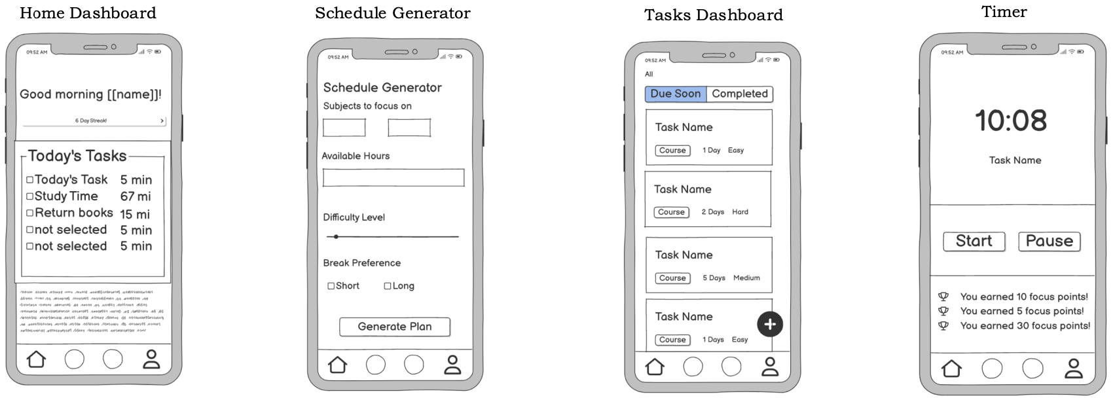
Wireframes

Slide 11
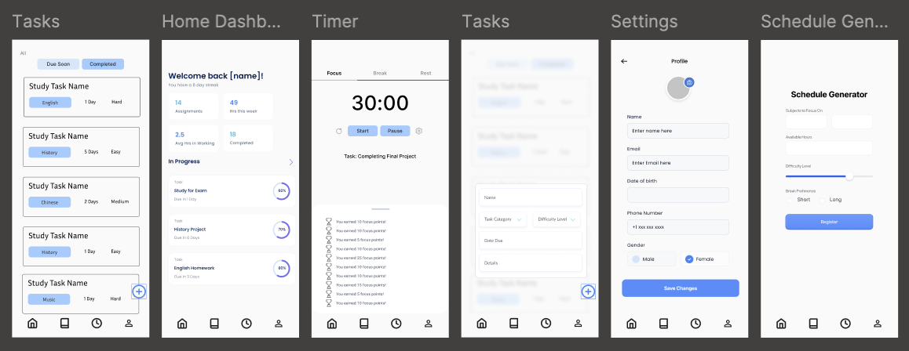
Wireframes (High Fidelity)

Slide 12
Information Architecture
Splash
Sign In
Tasks
Sign Up
Calendar
Onboarding
Focus Timer
Forgot
Auth
Progress Stats
Home
Settings

Slide 13
Five Planes of UX
Strategy | Targeted at students who need efficient, motivating study tools
Scope | AI scheduling, reminders, progress tracking, gamification
Structure | Logical navigation from onboarding → core features → reports
Skeleton | Layouts ensuring minimal clicks, clear hierarchy
Surface | Modern, bright visuals, balanced color ratio, rounded edges

Slide 14
MoSCoW Prioritization
Must Have | Should Have | Could Have | Won’t Have (Now)
AI Scheduler | Gamification | Voice Assistant | LMS Integration
Task List | Weekly Reports | Theme Options | Offline Mode
Reminders | Quick Add | Study Groups | Ads

Slide 15
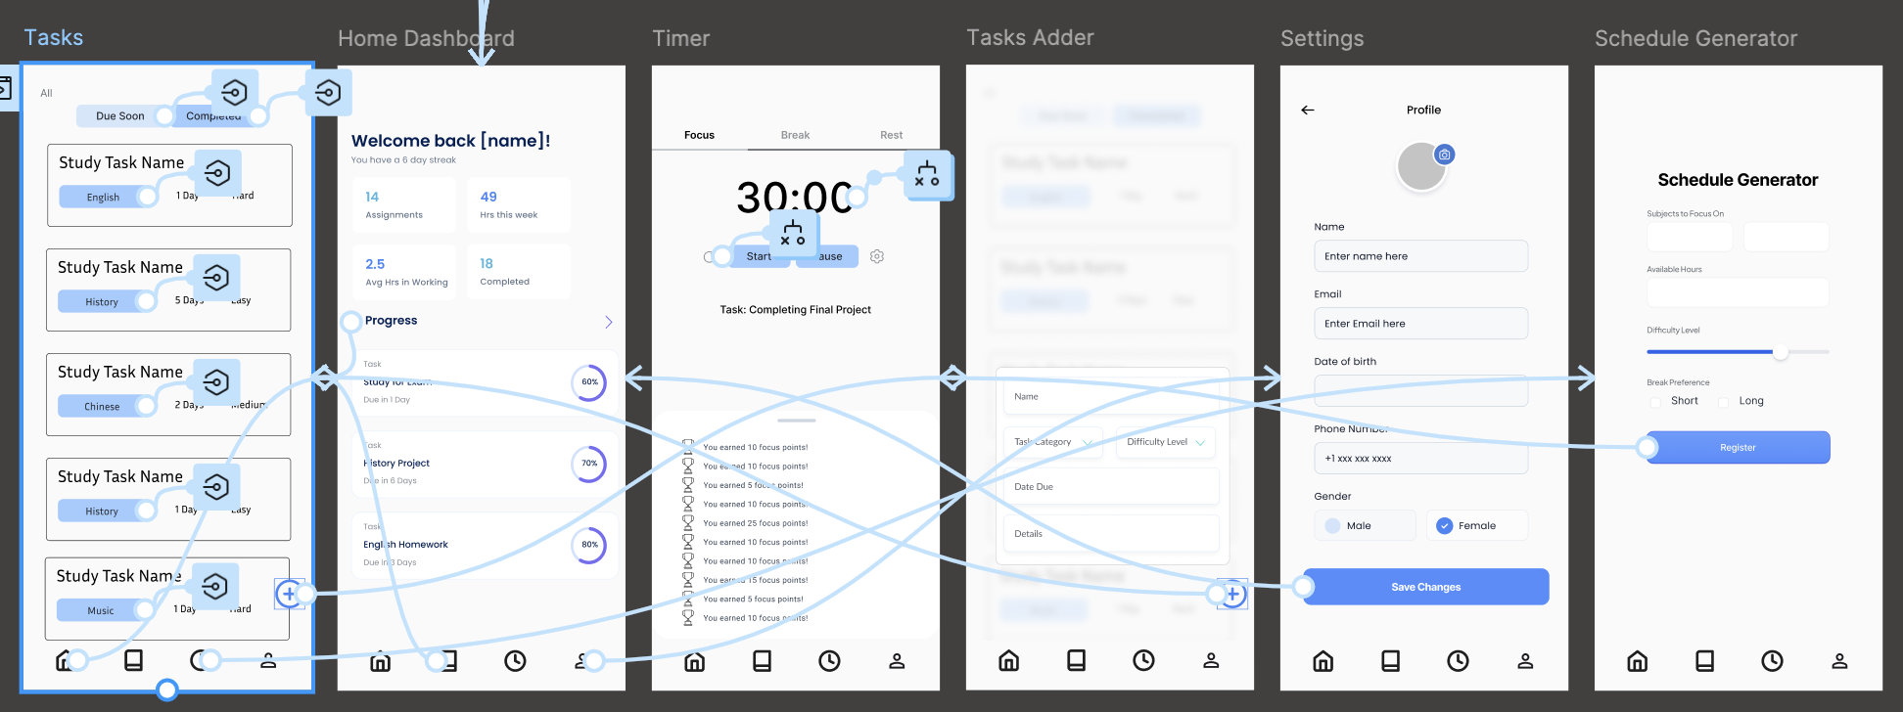
Figma Prototype
https://www.figma.com/proto/jPDDqiX9n0ZDuwndPnKV1Q/StudySync?node-id=0-1&t=6zHTeVTraAvAwnAR-1

Slide 16


Future Scope
Integrate with LMS platforms (Canvas, Moodle)
Voice assistant for hands-free planning
Adaptive AI scheduling based on productivity patterns
Peer study group matching

Slide 17

Conclusion
StudySync addresses real student pain points with a simple, motivating, and intelligent platform. By combining smart scheduling, gamification, and clean UI, it bridges the gap between intention and action for learners.

Slide 18

Thanks!

Slide 19

References
User Research - https://www.nngroup.com/articles/user-interviews/
SWOT Anaylsis - https://www.eda.gov/resources/comprehensive-economic-developmentstrategy/content/swot-analysis App Competitor Research
Notion – https://www.notion.so/
Forest App – https://www.forestapp.cc/
Todoist – https://todoist.com/
MyStudyLife – https://www.mystudylife.com/
Visual Tools
Balsamiq Wireframes – https://balsamiq.com/
Coolors.co – Color Palette Generator – https://coolors.co/
Google Fonts – Montserrat & Lato – https://fonts.google.com/

